Slide 1
YouTube Scrap Data Harvesting and Warehousing
Using SQL, MongoDB and Streamlit

Slide 2
Problem Understanding
The problem statement is to create a Streamlit application that allows users to access and analyze data from multiple YouTube channels. The application should have the following features:
Ability to input a YouTube channel ID and retrieve all the relevant data (Channel name, subscribers, total video count, playlist ID, video ID, likes, dislikes, comments of each video) using Google API.
Ability to collect data for up to 10 different YouTube channels and store them in the data lake by clicking a button.
Option to store the data in a MYSQL or PostgreSQL.
Ability to search and retrieve data from the SQL database using different search options, including joining tables to get channel details.

Slide 3
Approach
Set up a Streamlit app: Streamlit is a great choice for building data visualization and analysis tools quickly and easily. You can use Streamlit to create a simple UI where users can enter a YouTube channel ID, view the channel details, and select channels to migrate to the data warehouse.
Connect to the YouTube API: You'll need to use the YouTube API to retrieve channel and video data. You can use the Google API client library for Python to make requests to the API.
Store and Clean data : Once you retrieve the data from the YouTube API, store it in a suitable format for temporary storage before migrating to the data warehouse. You can use pandas DataFrames or other in-memory data structures.
Migrate data to a SQL data warehouse: After you've collected data for multiple channels, you can migrate it to a SQL data warehouse. You can use a SQL database such as MySQL or PostgreSQL for this.
Query the SQL data warehouse: You can use SQL queries to join the tables in the SQL data warehouse and retrieve data for specific channels based on user input. You can use a Python SQL library such as SQLAlchemy to interact with the SQL database.
Display data in the Streamlit app: Finally, you can display the retrieved data in the Streamlit app. You can use Streamlit's data visualization features to create charts and graphs to help users analyze the data.
Overall, this approach involves building a simple UI with Streamlit, retrieving data from the YouTube API, storing the data SQL as a warehouse, querying the data warehouse with SQL, and displaying the data in the Streamlit app.

Slide 4
Benefits
Benefits of Data Analysis:Audience Insights: Demographics, interests, and engagement metrics.
Content Optimization: Identifying high-performing content types, topics, and formats.
Decision Support: Data-driven strategies for content strategy, marketing, and monetization.

Slide 5
Exploratory Data Analysis (EDA)
Exploratory Data Analysis (EDA):Visualizing Data: Histograms, scatter plots, and heatmaps.
Identifying Trends: Seasonality, user engagement patterns, and content trends.
Statistical Analysis: Correlation analysis, hypothesis testing, and anomaly detection.

Slide 6
Data Collection Methods
Data Collection Methods:YouTube API: Retrieving channel details, video metrics, and comments.
Web Scraping: Extracting additional data from YouTube pages and external sources.
Data Storage: Storing raw and processed data in MongoDB and MySQL databases.

Slide 7
Implementation Steps
Implementation Steps:Data Collection: Harvest YouTube data using API calls and web scraping techniques.
Data Preprocessing: Clean, transform, and prepare data for analysis.
Exploratory Data Analysis (EDA): Visualize data, identify trends, and perform statistical analysis.
Machine Learning Modeling: Train predictive models for sentiment analysis, recommendation systems, etc.
Web App Development: Create interactive dashboards and visualizations using Streamlit or similar frameworks.
Testing and Deployment: Validate models, conduct usability testing, and deploy the web app for user access.

Slide 8
Business Goals
Business Goals:Harness YouTube data to understand audience behavior and content preferences.
Identify trends and patterns to optimize content strategy and audience engagement.
Improve decision-making through data-driven insights and predictive analytics.

Slide 9
Conclusion
Conclusion:Data analysis offers valuable insights for content creators, marketers, and businesses.
Enhanced decision-making and audience engagement through data-driven strategies.
Continuous iteration and improvement are key to maximizing the value of YouTube data analysis.

Slide 10
Next Steps
Next Steps:Continuous data collection and analysis.
Integration with other data sources (social media, website analytics).
Collaboration with content creators and marketers for further insights.

Slide 11
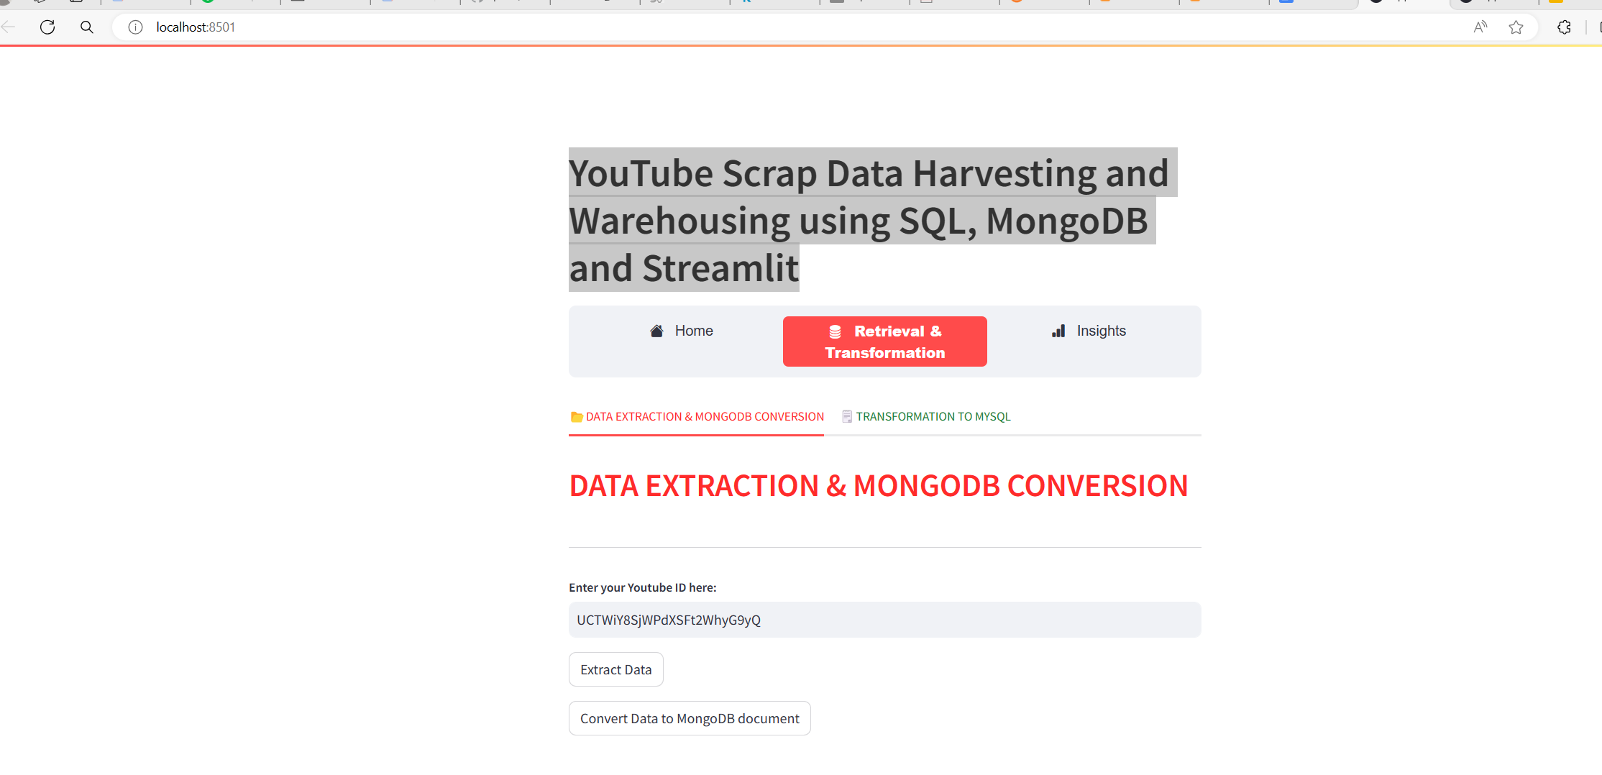
After Execution the home page

Slide 12
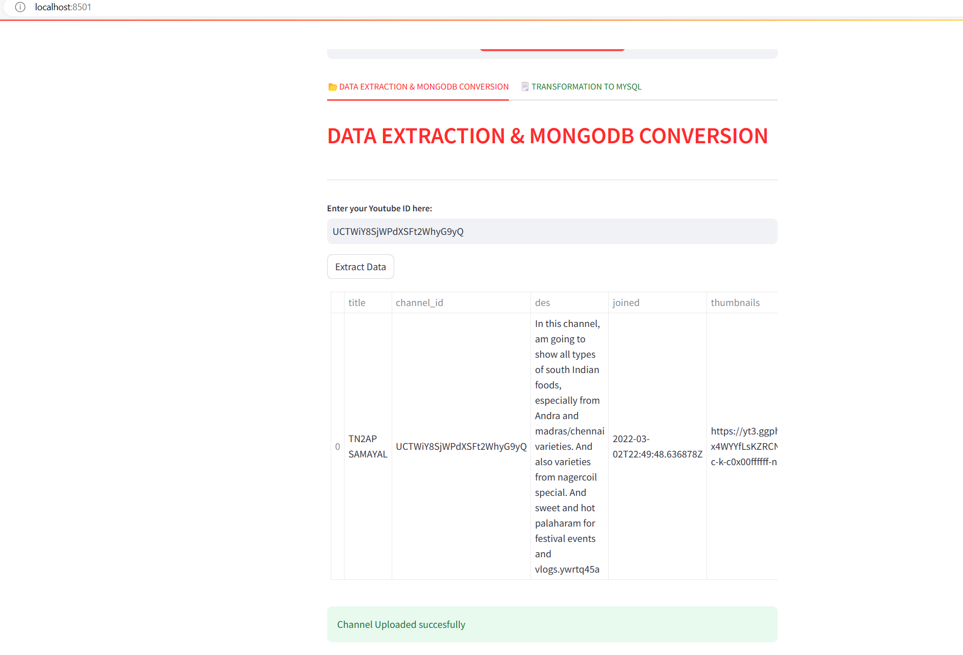
After entering the channel id

